Slide 1


Your Website's New
Audience is a Robot
HOW TASMANIAN TOURISM BUSINESSES CAN BE FOUND, RECOMMENDED AND BOOKED IN AN AI-FIRST WORLD
MARTIN ANDERSON
CEO + FOUNDER, IONATA
TICT CONFERENCE 2026
Notes:
OPENING POLL — do this before advancing to the next slide.
1. 'Before we get into it, quick show of hands. How many of you have searched for information about your own organisation using an AI tool — ChatGPT, Claude, Gemini, Perplexity?'
(Wait for hands — should be a good number)
2. 'OK, good. Now — how many of you were happy with what it said?'
(Watch hands drop, laughs, groans)
'That gap — between using AI search and trusting what it says about YOU — is exactly what the next 45 minutes is about.'
Then advance to the 93% slide.

Slide 2
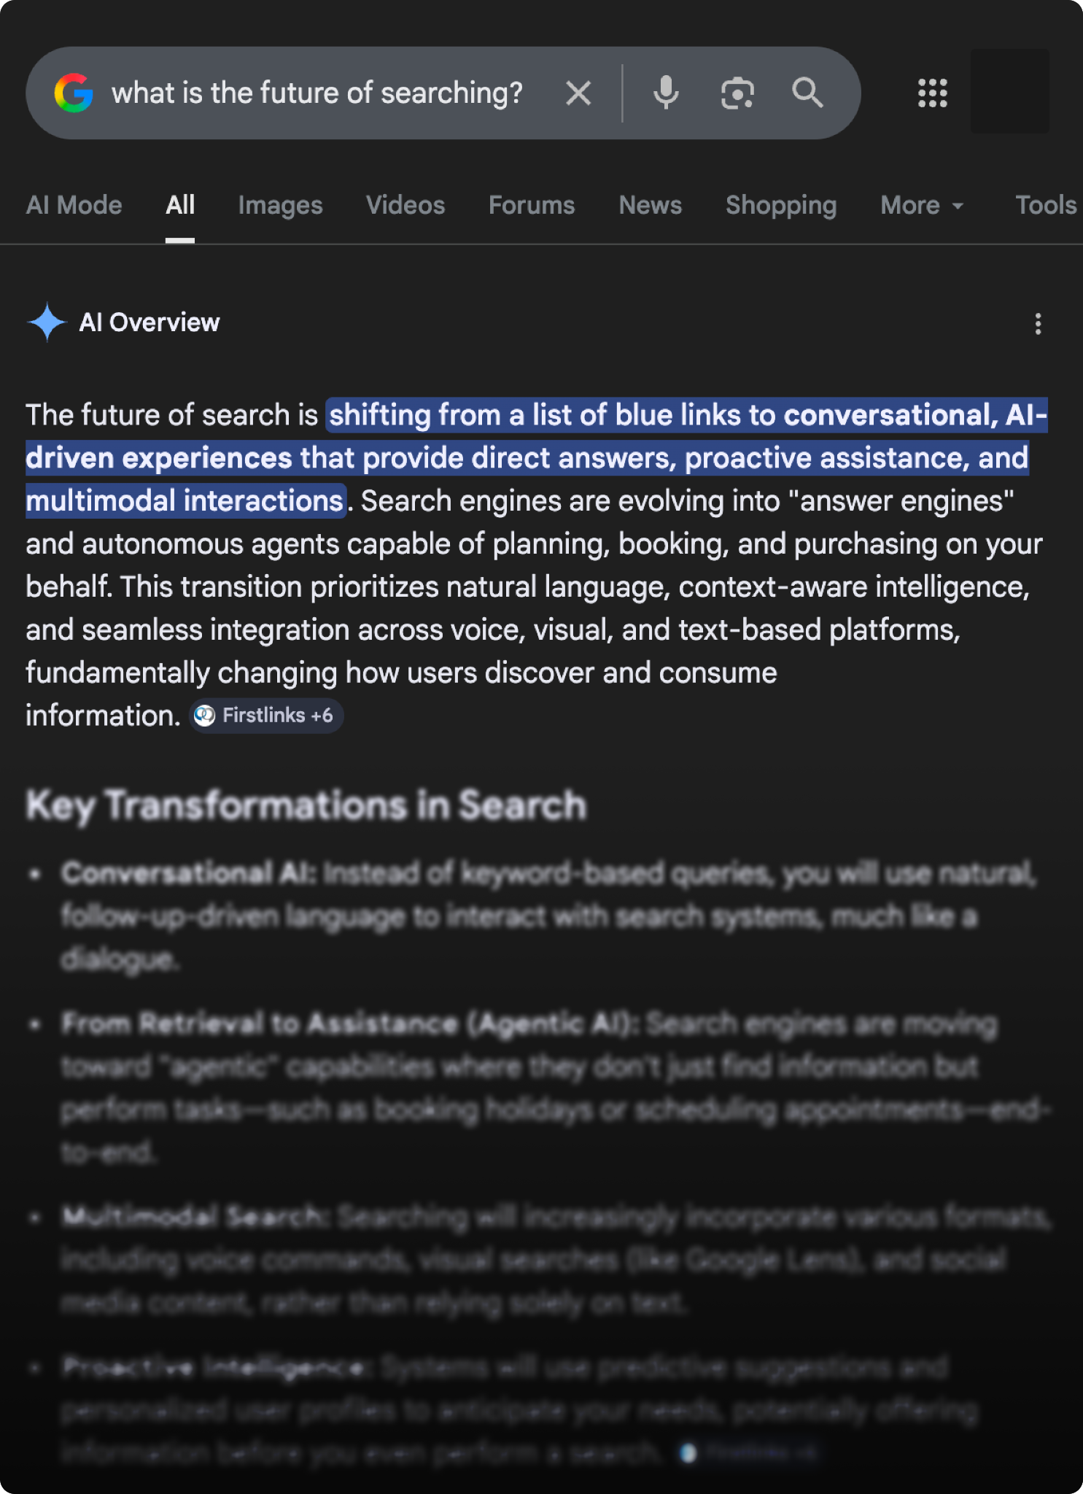
93%
of AI Mode searches end
without a single click
SOURCE: SEMRUSH, 2025
Notes:
Open with this. Let it sit. Then ask: 'If 93% of searches don't click, what's the point of a website?' Pause. This is what everyone's asking. The answer will surprise them.

Slide 3
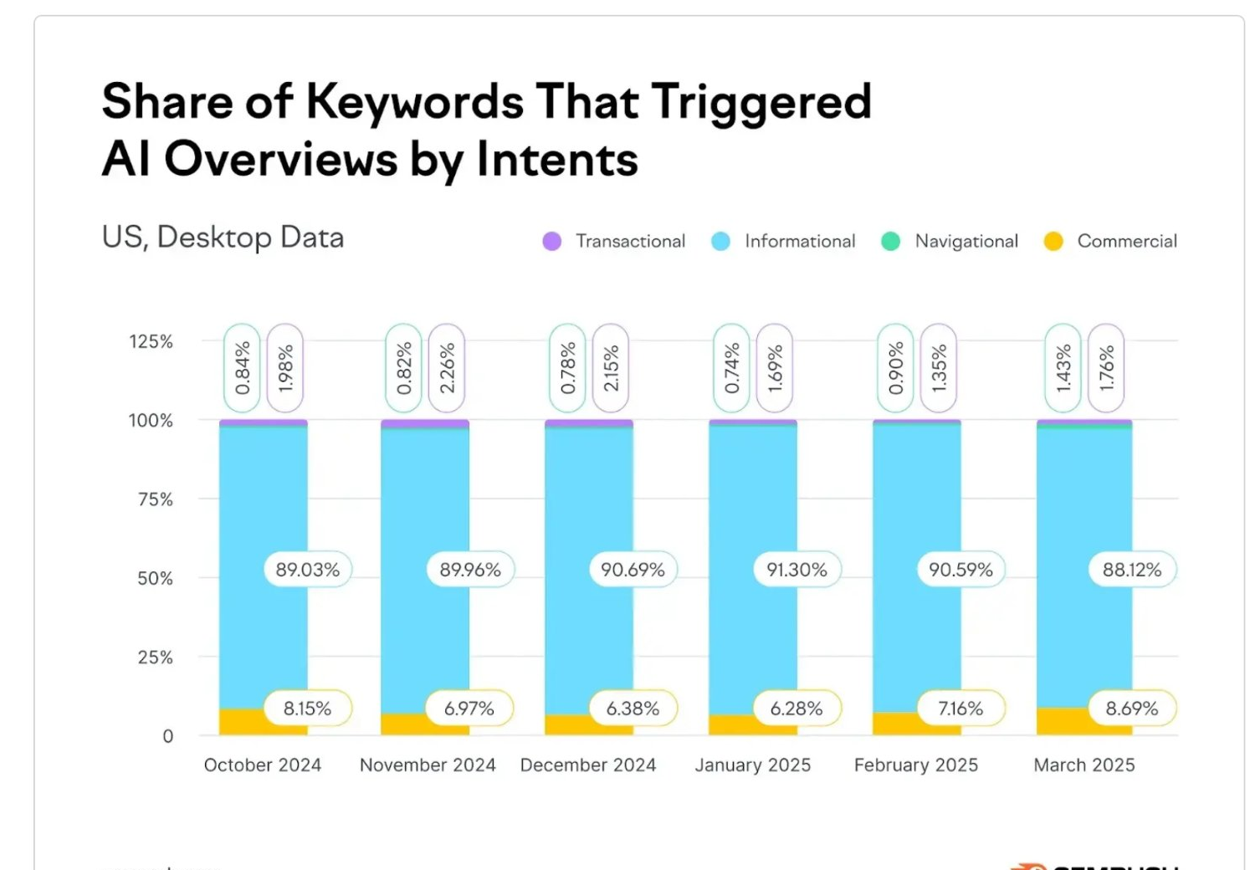
88% of the queries AI is answering are informational
“I want to learn” queries are absorbed by AI.
The clicks that remain are high-intent: people
ready to act.
Notes:
Build on the 93%. 'Nearly 9 in 10 queries AI answers are informational — people wanting to learn something. Opening hours, definitions, how-to basics. But look at what's LEFT: commercial, transactional, navigational queries. The valuable clicks. AI is essentially filtering out the tyre-kickers and leaving you with the serious visitors.'

Slide 4
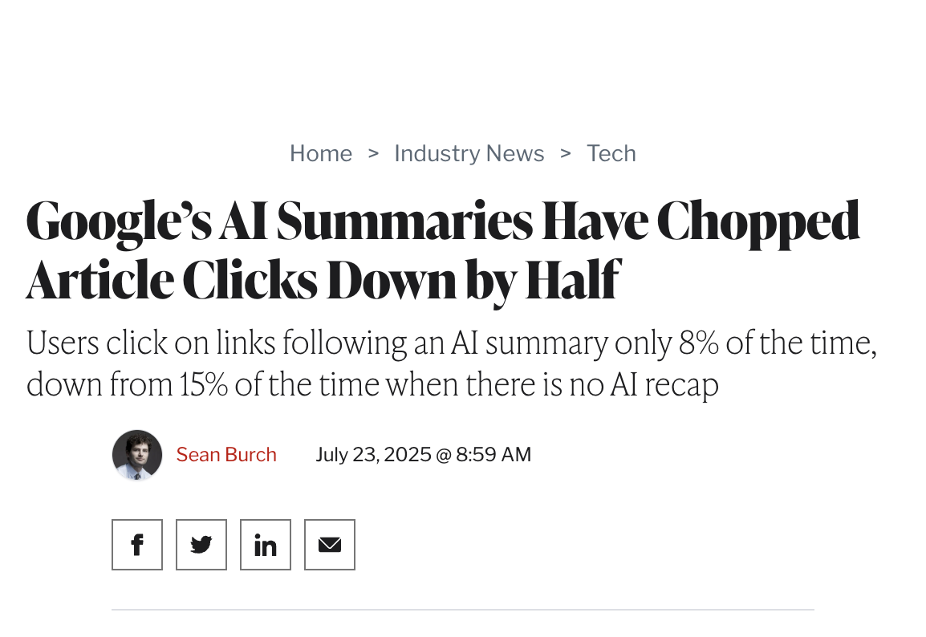

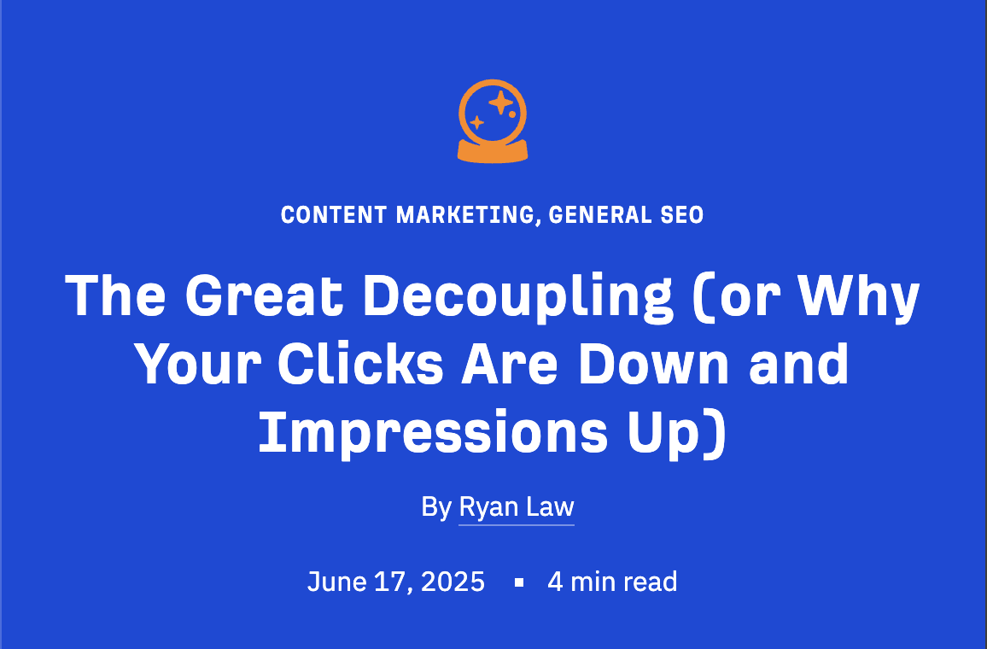
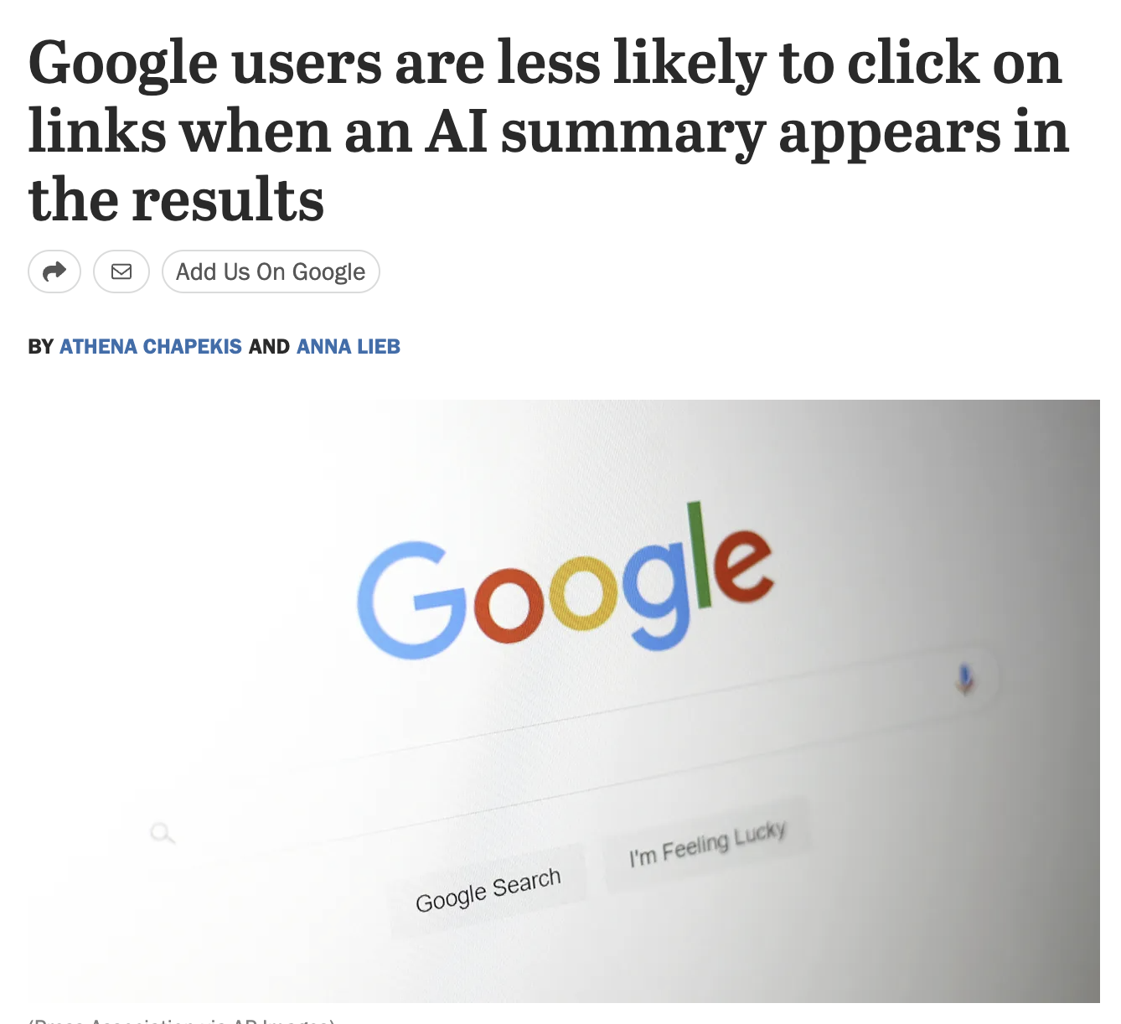
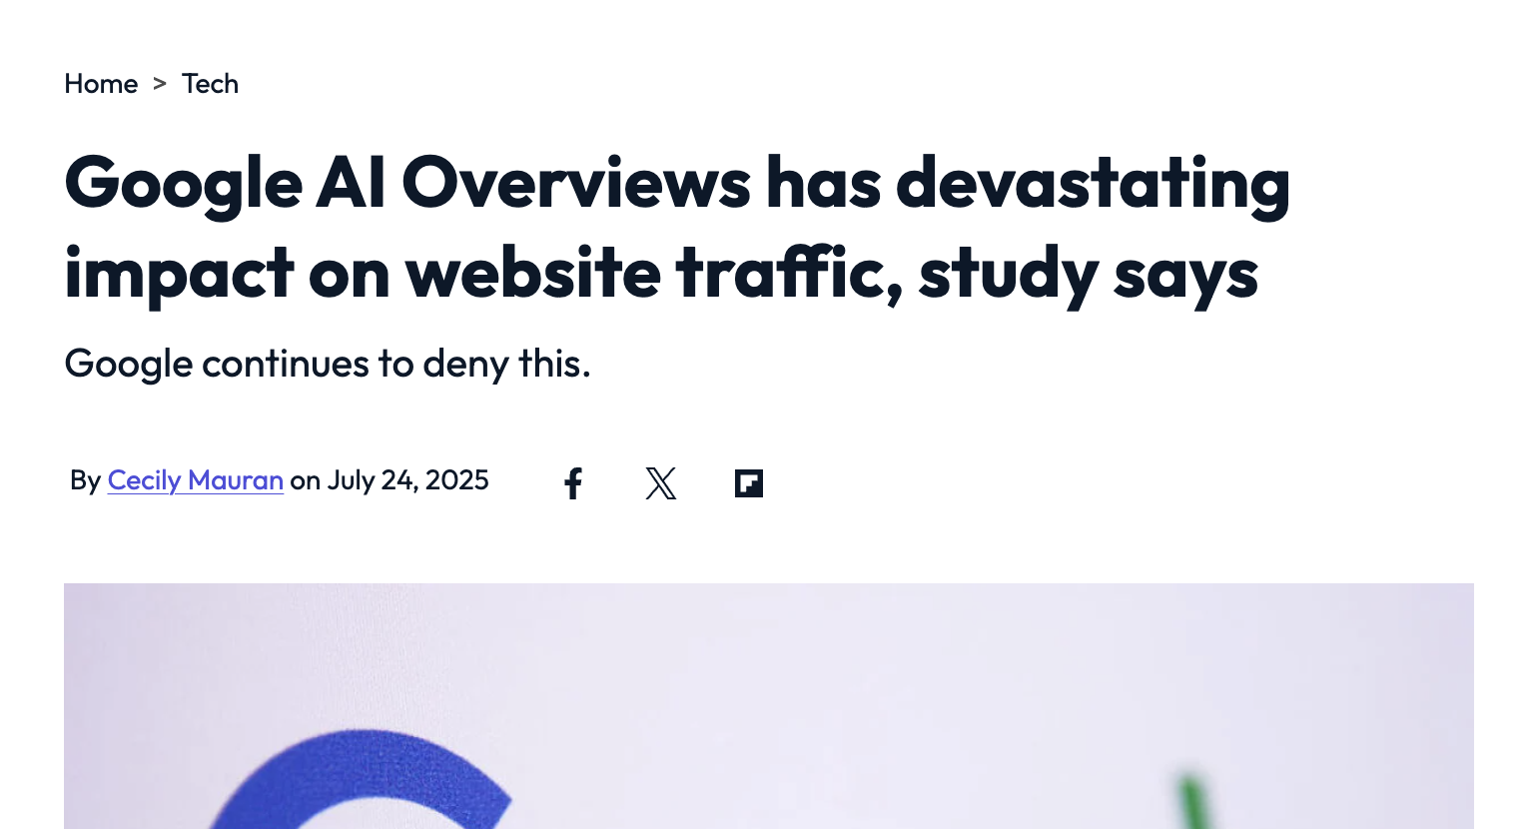
"The Great Decoupling"
People are searching more than ever.
They're just not clicking through.
Pew Research: clicks drop from 15% to 8% when AI summaries appear
— a 46.7% reduction, tracked across 68,000 real queries
Notes:
Introduce 'The Great Decoupling' as a phrase. Search volume is UP. Clicks are DOWN. That's not the web dying — it's the relationship between searching and clicking breaking apart. Ground it with Pew data: 68,000 real queries, behavioural data not surveys. Even the most conservative research shows a 47% click reduction.

Slide 5




So conventional wisdom says:
"Websites are becoming irrelevant"
Conversations moved
to platforms
Conversions shifted
to apps & social
AI gives answers
without clicking
Notes:
Walk through the doom narrative the audience has heard. Let it breathe. Then...

Slide 6



The reality is very different.
AI search has brought the website back to centre stage.
ChatGPT, Claude, Gemini, Perplexity — they all need a source.
And in many cases, that source is your website.
Notes:
THE PLOT TWIST. Pause before this slide. AI has actually REVERSED the decline. These LLMs need authoritative sources. Your website IS that source. More important than ever — just in a different way.

Slide 7



This isn't about pageviews.
You make money from bookings. From tours that run. From experiences people actually show up for.
Accuracy
Authority
Conversion
Are you the cited source, or is someone else speaking for you?
When someone needs to act — can they find you?
Is AI saying the right thing about you?
Notes:
KEY REFRAME for this audience. The zero-click crisis is a publisher problem. For everyone in this room, the stakes are different: misinformation, loss of authority, broken paths to action. Not lost ad revenue.

Slide 8
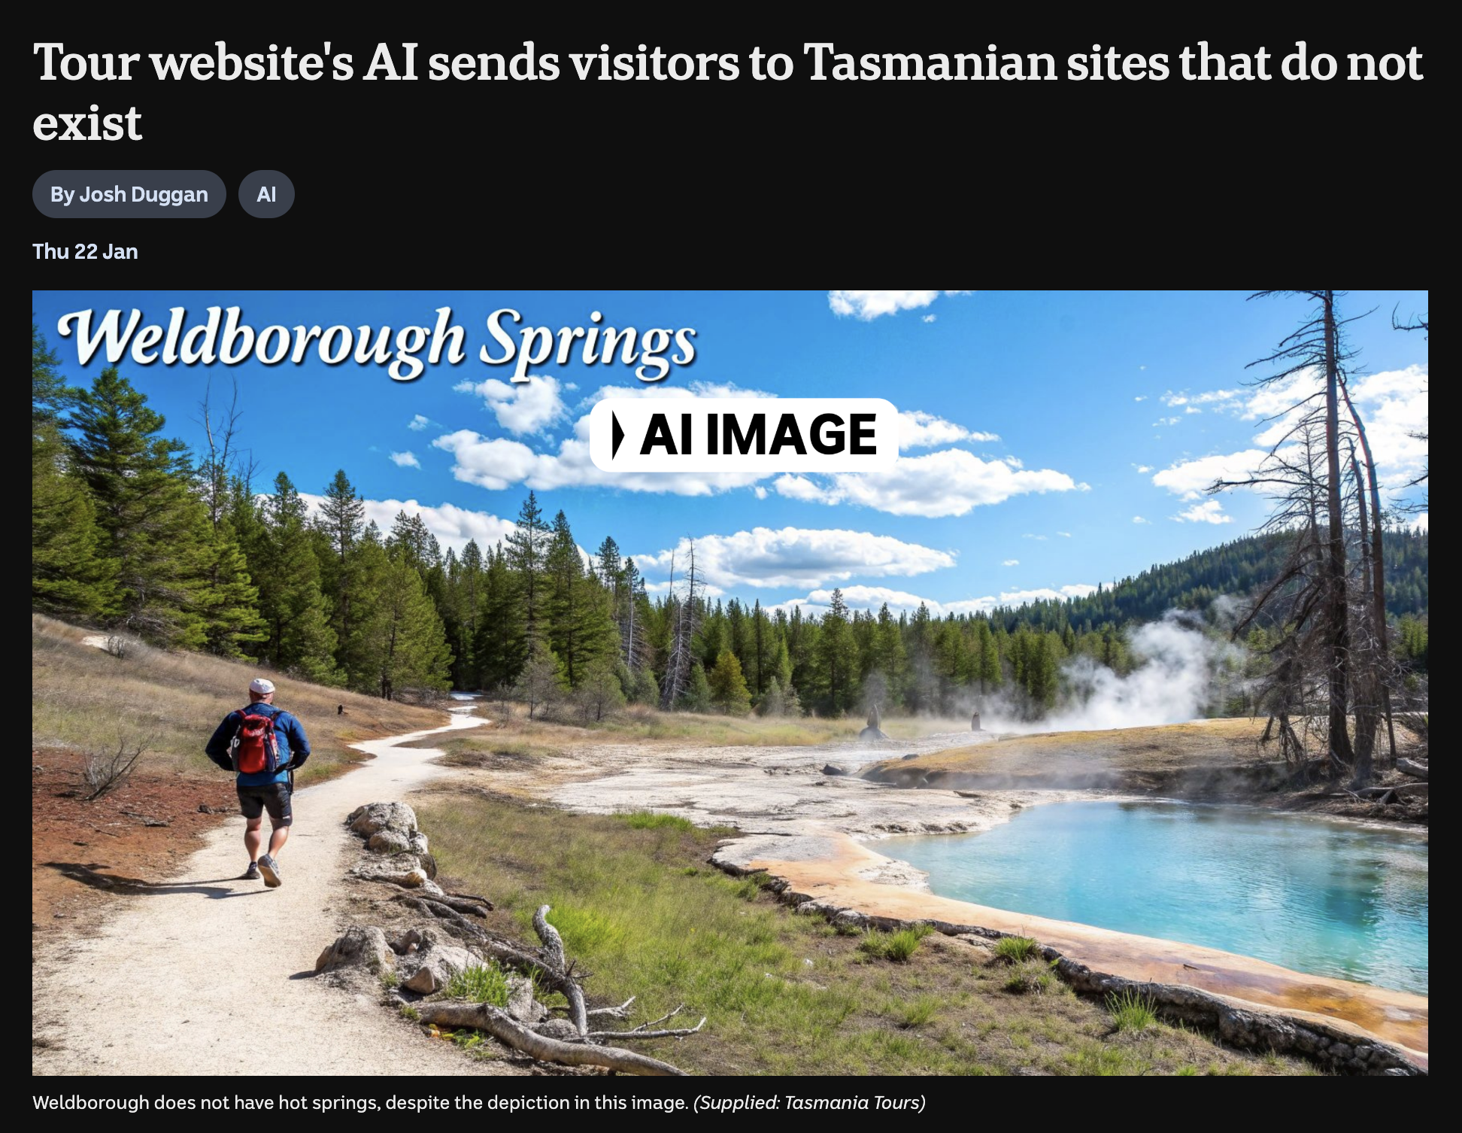
Weldborough, Tasmania — January 2026
Dozens of visitors drove to a remote former mining village based on information from an AI-generated blog post. A group of 24 mainland drivers took a special detour specifically for it.
“If you find them, come back and tell me, and I’ll shout you beer all night.”
🍻
Image: ABC News • abc.net.au • 90% of AI itineraries contain errors (Prof. Anne Hardy)
Notes:
'Some of you might have seen this story in January.' Tell it conversationally. Let the image do the work — it looks completely real. The lesson isn't 'don't use AI.' It's: when authoritative sources are absent, AI fills the gap with hallucinations. Then say: 'And it's not just tourism...' and advance to the next slide.

Slide 9
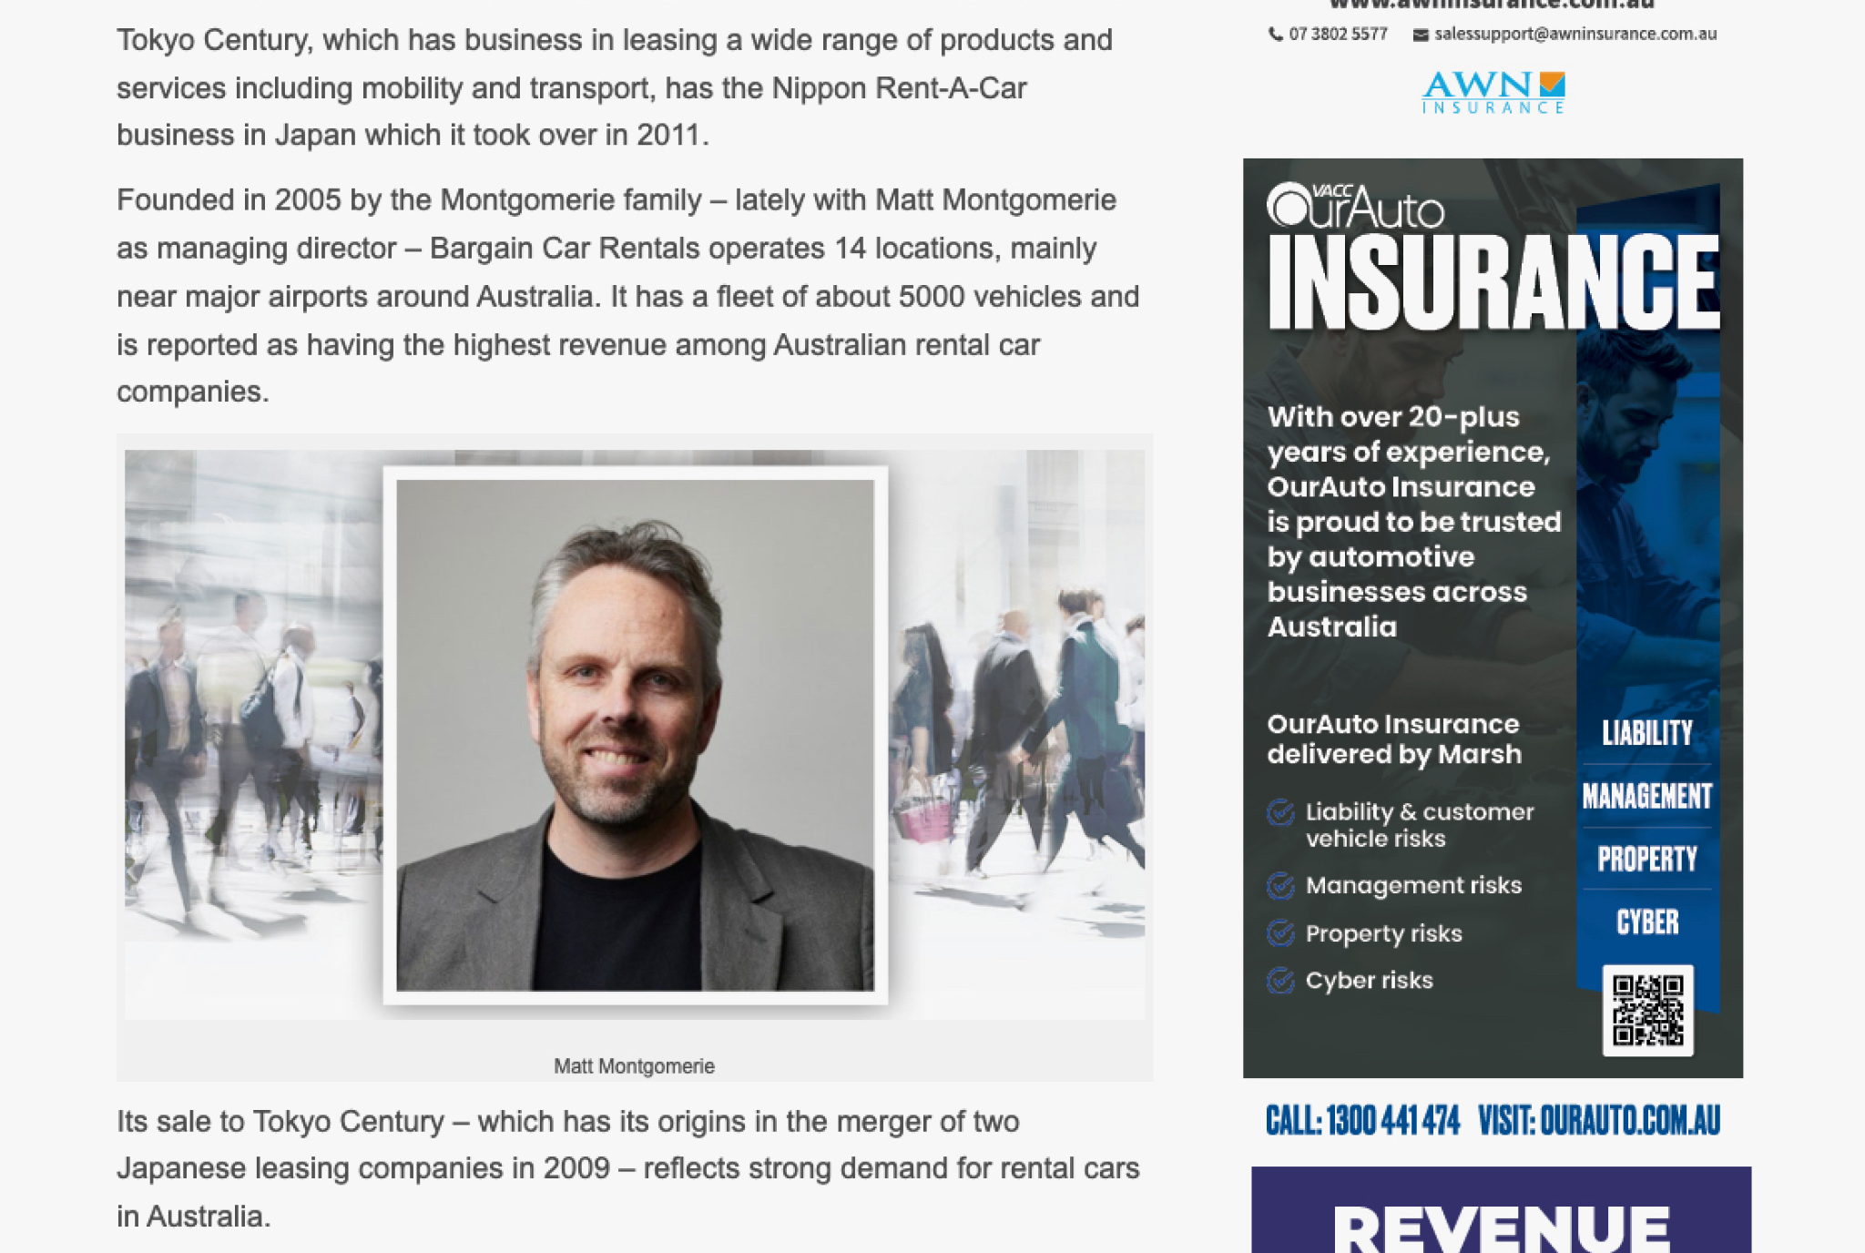

Bargain Car Rentals, Hobart — March 2026
Earlier this year, an article about the sale of Bargain Car Rentals — one of our clients, was published with:
The wrong person named as the owner
Someone else’s photo used for the owner
Misrepresented details of the transaction
Notes:
'Some of you might have seen this story in January.' Tell it conversationally. Let the image do the work — it looks completely real. The lesson isn't 'don't use AI.' It's: when authoritative sources are absent, AI fills the gap with hallucinations. Then say: 'And it's not just tourism...' and advance to the next slide.

Slide 10


Someone else is answering questions about your business
51.6%
of Australian tourist attraction web traffic goes to just three OTAs
$9.2M
spent by GetYourGuide alone on Australian Google ads last year
Notes:
They are not experience providers. They are intermediaries — and they are building citation control in AI at the same time they are winning paid search.You cannot outspend them. But you can out-authorise them.

Slide 11
The most expensive customer you will ever acquire
Operators paying to rank for their own name
because OTAs are outbidding them
Wilsons Prom — 90% of traffic on their own brand keyword flows through paid ads
Perth Mint — 89%
Thredbo — 88%
Queen Victoria Market — 79%
Rottnest Island — 74%
Notes:
In a healthy category, you should win your own brand cheaply and organically.In Australian tourism, that pattern has broken. OTAs bid on your name. You are forced to bid back — at OTA-level prices — just to reach a customer who was already looking for you

Slide 12
The Traffic Paradox
Fewer clicks. Dramatically better visitors.
TRADITIONAL SEARCH
AI SEARCH
2.8%
14.2%
conversion rate
conversion rate
5x higher conversion • 38% longer visits • 527% YoY growth
Notes:
The big aha. Total clicks down, but visitors who DO arrive from AI convert at 5x. Volume is scary. Quality is incredibly promising.

Slide 13
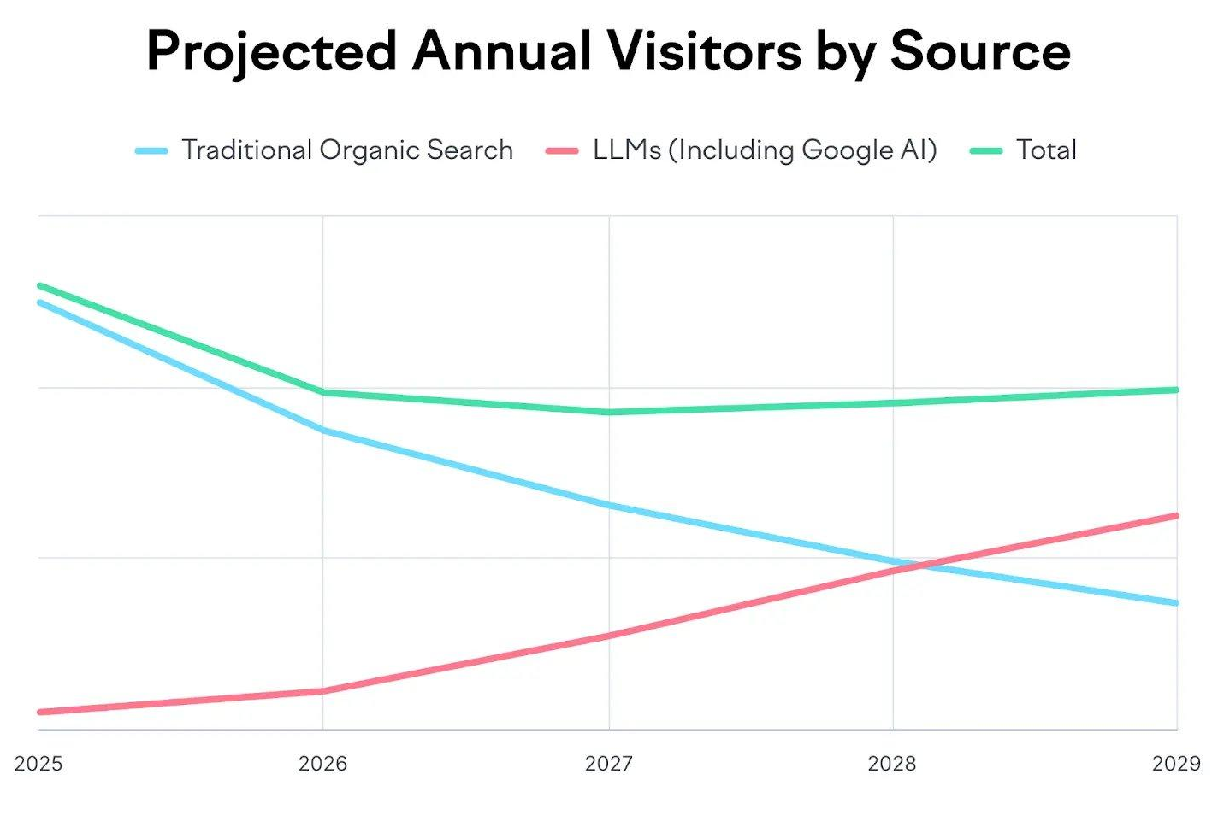
The Crossover is Coming
LLM referral traffic is projected to overtake traditional organic search by 2028
The source is shifting, not disappearing. Source: Semrush
Notes:
Point to 2026 on the chart. 'We are right here.' The green Total line stays flat — traffic isn't disappearing, the SOURCE is shifting. The question isn't whether this happens — it's whether you're ready.

Slide 14



Your Website Now Has Three Audiences:
Humans
with Intent
AI Crawlers
AI Agents
Fewer visits, but they arrive with genuine purpose. Already filtered through AI.
LLM bots crawl more often than Google. Reading your site to train and cite.
Autonomous software that browses, compares, and transacts on behalf of users.
Notes:
KEY REFRAME for this audience. The zero-click crisis is a publisher problem. For everyone in this room, the stakes are different: misinformation, loss of authority, broken paths to action. Not lost ad revenue.

Slide 15
AI is being asked about your experience. But who is it citing?
Who gets cited?
The concentration problem
Destination Marketing Organisations appear in nearly every discovery answer
Mainstream travel media: Time Out, Tripadvisor, Lonely Planet, Atlas Obscura
OTAs: GetYourGuide, Viator, Klook - especially for booking queries
Wikipedia: cited in 60-80% of answers about specific attractions
Google AI Overviews now appear on most 'things to do in [place]' queries.
The source set is typically 4 to 6 entities — consistent, repeated, hardening.
Operators are named. But they are rarely cited as the source.
Notes:
In a healthy category, you should win your own brand cheaply and organically.In Australian tourism, that pattern has broken. OTAs bid on your name. You are forced to bid back — at OTA-level prices — just to reach a customer who was already looking for you

Slide 16




What AI Needs From Your Website:
Structured Data
Clear Answers
Clean semantic HTML. Schema markup. Machine-readable content.
Content that directly answers the
real questions people ask.
Crawlability
Authority Signals
Fast, well-organised sites accessible
to AI scrapers and agents.
E-E-A-T: Experience, Expertise,
Authoritativeness, Trustworthiness.
Notes:
What makes a website AI-friendly. These aren't new concepts — but they matter more than ever because AI is using them to decide WHO to cite.

Slide 17

Good news: the fundamentals haven’t changed.
The same techniques that make a site accessible make it readable by AI.
Plain language & logical content flow
AI summaries are built from clear, structured prose
Descriptive alt text on images
AI crawlers read alt text to understand visual content
Clear navigation & information architecture
AI agents need logical paths to traverse a site
Semantic HTML — <h1>, <nav>, <main>
LLMs parse heading hierarchy to understand structure
Fast loading website
Slow pages frustrate human visitors and AI crawlers alike.
Notes:
THE PRESSURE RELEASE. 'I know this feels like a lot. AI agents, protocols, zero-click — it's moving fast. But the fundamentals haven't changed. If you're producing authoritative content in clean semantic HTML, you're well placed to ride out the storm. You don't need to throw everything out. You need to do the basics brilliantly.'

Slide 18




What this means for Tasmanian tourism
$3.8 billion in annual visitor spend — travellers are planning trips via AI right now
Tasmania is a long-haul destination. Visitors research extensively before committing. That research is increasingly happening in AI.
Tasmanian experiences are distinctive, place-specific and hard to replicate. These are exactly the qualities AI rewards when the content is there to signal them.
The OTA dominance seen nationally is present here. Independent operators face the same structural pressure but have a genuine advantage in authenticity and local authority that global platforms cannot match.
The operators who build that authority in the next 12 months will compound. The ones who wait will pay OTAs forever.
Notes:
Localise everything. Make it about Tasmania. Mention specific councils, tourism operators, the Service Tasmania portal. Reference the Weldborough story again. This audience is predominantly public sector — speak their language.

Slide 19
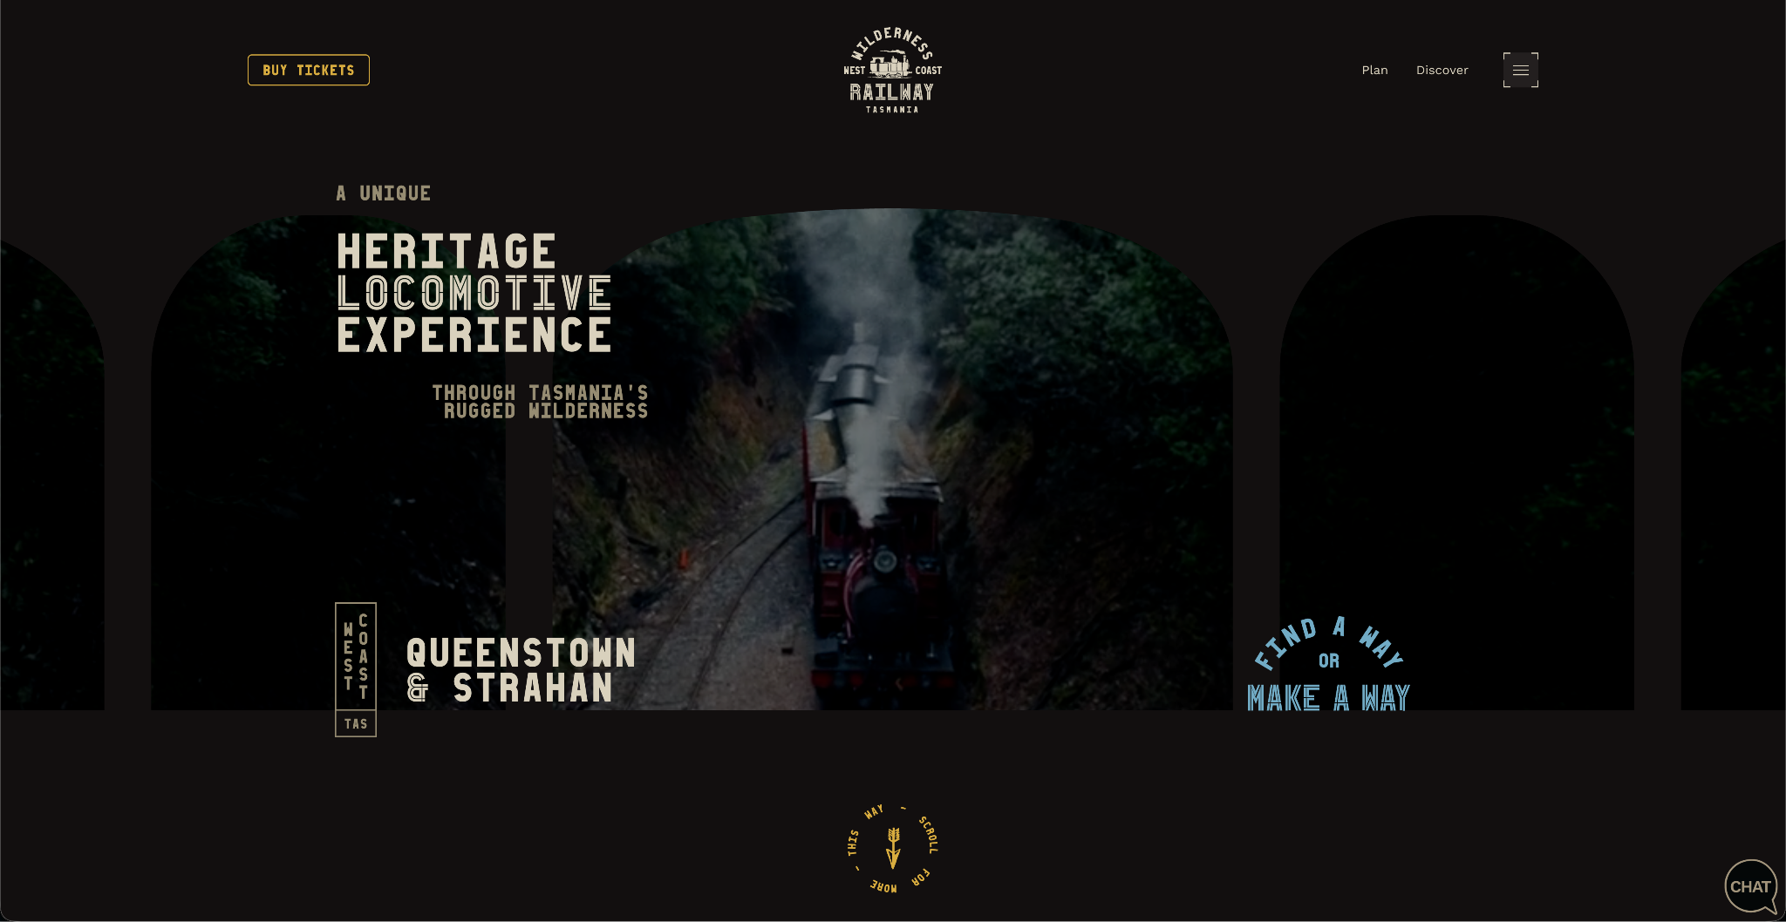
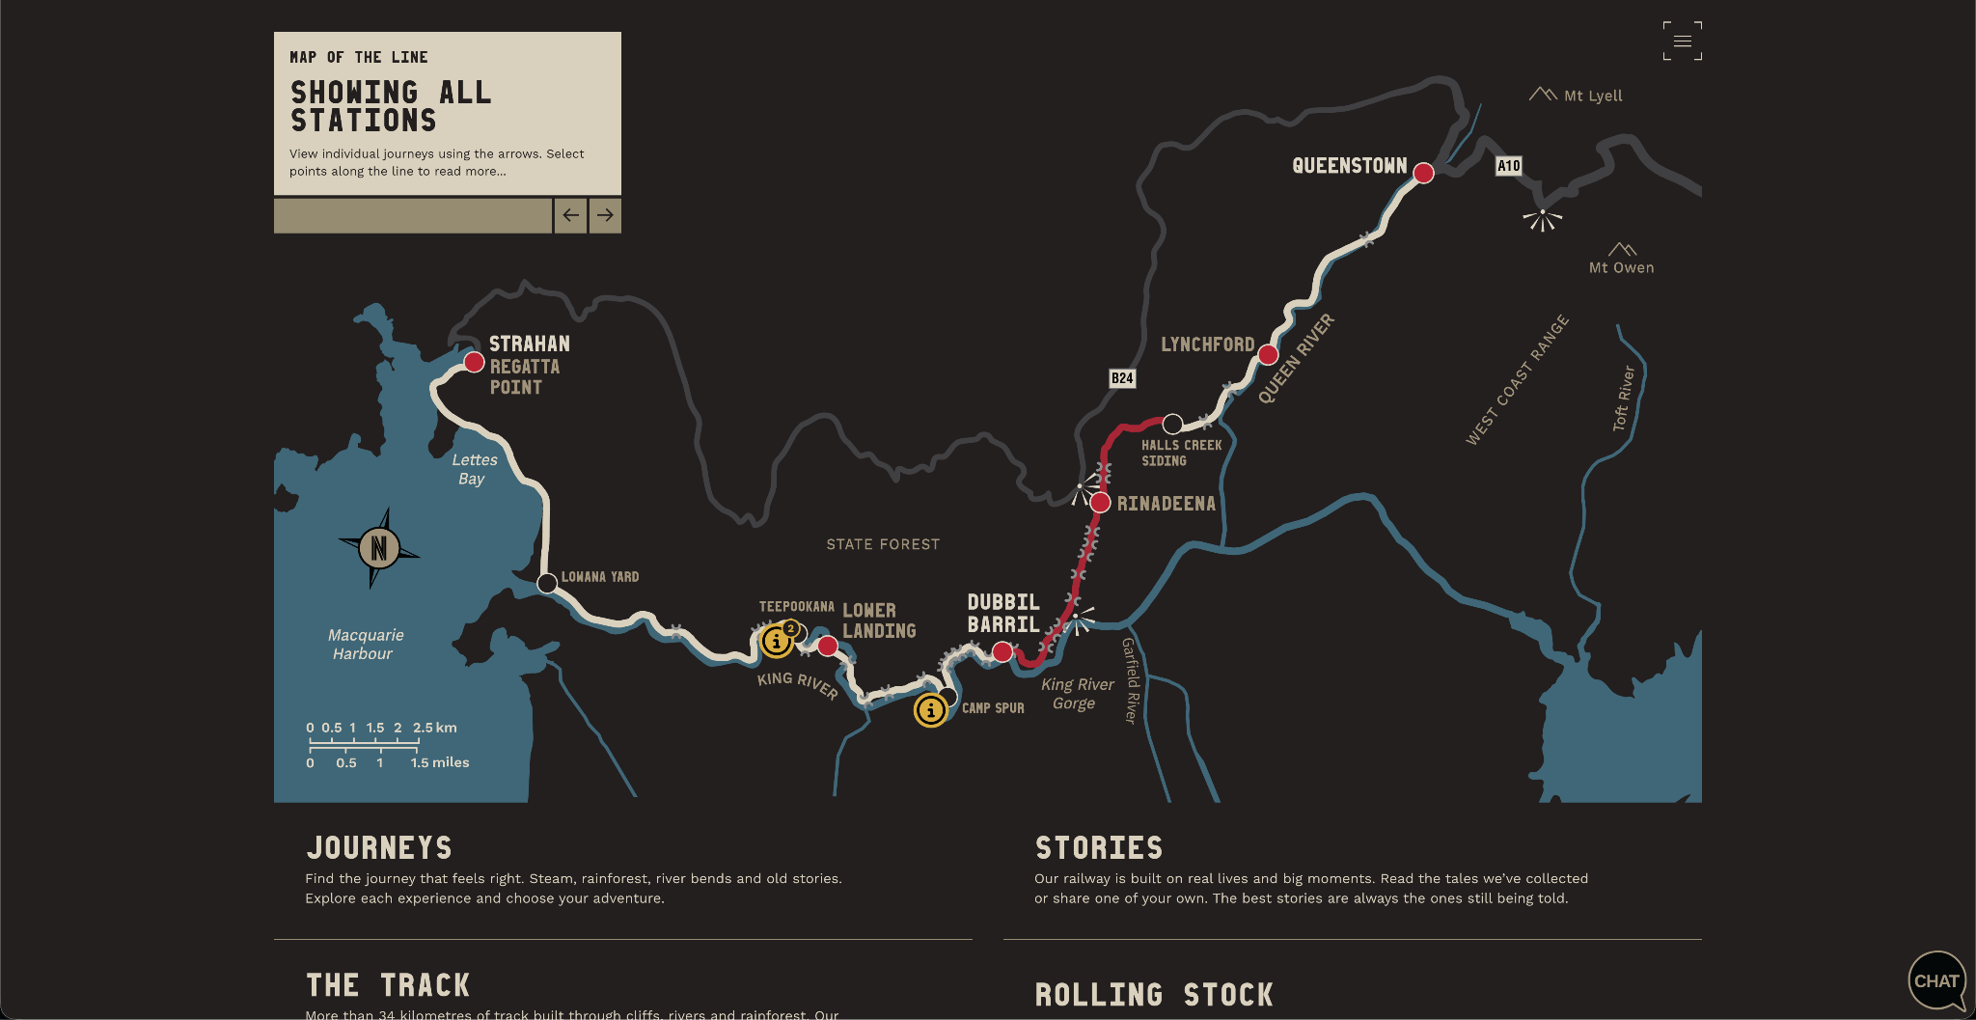
What does that look like in practice?
West Coast Wilderness Railway
DIEMEN AWARD WINNER - BEST WEBSITE 2026
Notes:
This isn't about competing with ChatGPT. It's about making your own website actually useful. The content is yours, answers are sourced, the citizen stays on your site. Three layers: LLM understands intent, Elasticsearch retrieves content, AI summarises with links. Way better than keyword search on a 500-page council site.

Slide 20
What to do starting today
Five actions to make your website
ready for its robot audience - and a +1

Slide 21
1
Audit Content for AI Readability
Is it structured? Does it answer real questions? Can a machine parse it?
Check Your AI Visibility
2
Search for your business in ChatGPT, Claude, Perplexity, Gemini. What comes up?
3
Invest in First-Party Data
What are people actually searching for on your site? Use search data to drive content.
4
Think Agent-Friendly
Structured data, clean markup, machine-readable service information.
5
Own the AI Experience
Don't cede the answer to an OTA or a hallucination. Be the source, not the subject.
Notes:
Concrete actions. 1) Look at your top 20 pages — are they answering questions? 2) Literally go to ChatGPT and ask about your org. 3) Site search logs are gold. 4) Schema markup, clean HTML. 5) Don't wait for AI to represent you — bring it to your platform. Ionata AI Summary Search is option 5 in action.

Slide 22
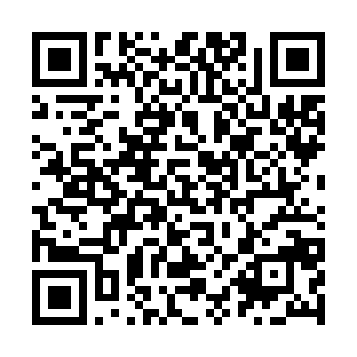
And the +1
Fix your Google Places listing.
Let’s check your Google Places listing now.
You might be surprised what you find.
Notes:
Concrete actions. 1) Look at your top 20 pages — are they answering questions? 2) Literally go to ChatGPT and ask about your org. 3) Site search logs are gold. 4) Schema markup, clean HTML. 5) Don't wait for AI to represent you — bring it to your platform. Ionata AI Summary Search is option 5 in action.

Slide 23
Your website is more
important than ever.
Just not for the reasons you think.
Notes:
'Your website is more important than ever. Just not for the reasons you think.' Pause. Thank the audience. Open for questions.

Slide 24
A TASMANIAN TOURISM CASE STUDY
From Google to ChatGPT
How eGuide Adapted to Every Major Change in Travel Search
24 years operation
David Hearle Founder, eGuide
Notes:
Welcome — introduce this as a case study in adapting to search platform shifts.

Slide 25
2002 – 2015
The Google Years
OUR CHALLENGE
How did we get found on Google?
96
eGuide wasn't yet operating tours — we helped travellers find trusted destination information, and earned revenue through Booking.com, Viator and Google Ads.
destination websites built
Destination guides · accommodation information · travel advice
The more visitors Google sent us, the more successful we became.
Notes:
Set the scene: eGuide started as a publisher, not an operator, chasing Google traffic.

Slide 26
2002 – 2015
How We Won on Google
GOOGLE REWARDED
Key Words came up
Specialist websites
Original content
Strong SEO
NoosaEguide.com
Internal linking
External links
Regular updates
Noosa Accommodation
SydneyEguide.com
Our goal was simple: when someone searched, we wanted our website to be the answer.
Sydney Tours
BangkokEguide.com
Bangkok French Restaurants
Notes:
What Google's ranking factors actually rewarded, and the searches eGuide won.

Slide 27
2015
Our Business Model Changed
THE TRAVEL INDUSTRY CHANGED
GOOGLE INCREASINGLY REWARDED
Booking.com became the destination. Viator became the destination. Travellers booked directly.
Expertise
Authority
Trust
Real businesses
↓
Affiliate commissions declined
We needed a new business model.
Notes:
2015 pivot point: OTAs disintermediated affiliates, and Google's criteria shifted toward trust signals.

Slide 28
2015 ONWARD
From Publisher to Tour Operator
We stopped selling other people's tours. Instead we invested in our own vehicles, created our own tours and transport, and employed local guides.
Overland Track Shuttle
Hobart Shore Excursions
Burnie Shore Excursions
Walls of Jerusalem Transport
But we still relied on Google Search.
Notes:
eGuide stopped being an affiliate and became a real operator, building specialist brands.

Slide 29
2024 – 2026
From Google Search to AI Search
YESTERDAY, PEOPLE SEARCHED
TODAY, THEY ASK
Overland Track transport
How do I get to Cradle Mountain without hiring a car?
What's the best shore excursion in Burnie?
How can I travel around Tasmania without driving?
Google helped people find websites. AI recommends businesses it trusts.
Notes:
The 2024-2026 shift: from keyword search to conversational AI queries.

Slide 30
THE REFRAME
Instead of asking
How do we optimise for ChatGPT?
We asked
How do we become the business AI wants to recommend?
Notes:
This is the pivotal reframe of the entire talk. Give it room to land.

Slide 31
THE REBUILD
We Rebuilt the Website Around Questions
Instead of describing tours, we answered traveller questions.
How do I get to the Overland Track?
Which airport should I fly into?
Can I leave luggage?
What if I finish early?
Every customer question became another helpful answer online.
Notes:
Concrete example: the website shifted from describing tours to answering real traveller questions.

Slide 32
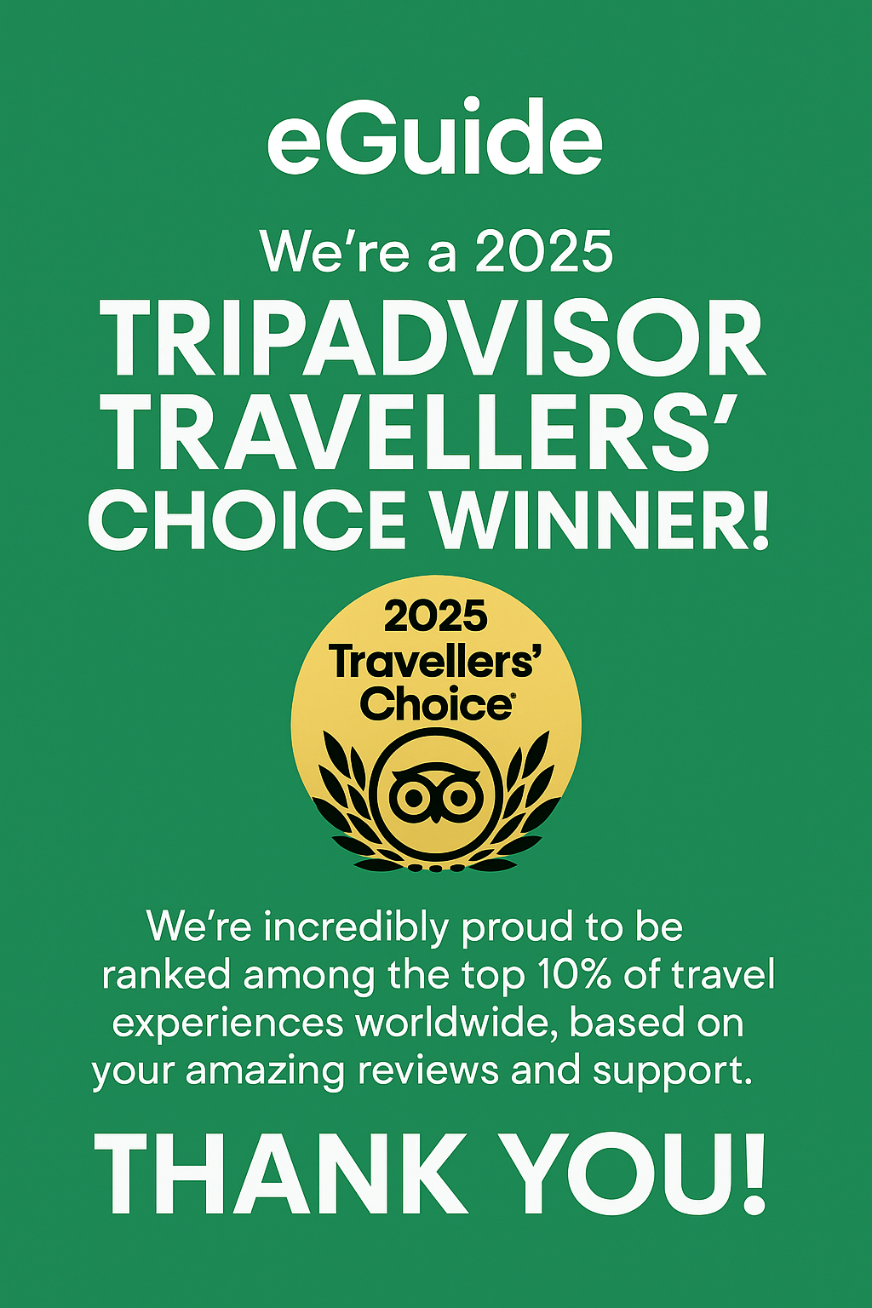

THE PROOF
We Made Our Expertise Visible
Expertise isn't something you claim. It's something you demonstrate.
24 years of experience
Tourism awards
Real guides and drivers
Original photos and videos
Customer reviews
Daily operational knowledge
Notes:
Proof over claims: expertise had to be demonstrated, not stated.

Slide 33
THE SYSTEM
We Built Digital Authority
Industry Partnerships
Social Media
Original Content
Reddit
eGuide
Website
YouTube
Reviews
Google Business Profile
Notes:
The hub diagram: AI reads eGuide's reputation across every channel, not just the website.

Slide 34
THE DISCIPLINE
We Keep Everything Current
Tourism information changes constantly. Our website became a living resource — we regularly update:
EVERY UPDATE TELLS AI
Prices
Timetables
Cruise schedules
This business is active.
Seasonal advice
Road conditions
This information is current.
Booking information
This information can be trusted.
Notes:
Freshness as a trust signal — regularly updated information tells AI the business is active.

Slide 35
THE DIFFERENCE
Google vs. AI
GOOGLE MOSTLY JUDGED ONE THING
AI LOOKS FOR EVIDENCE EVERYWHERE
Your website.
Website
Reviews
Google Business Profile
YouTube
Reddit
Social media
Industry partners
Current information
Everything reinforces one message: eGuide knows Tasmania.
Notes:
The core reframe of the whole talk: Google judged a webpage, AI judges a reputation.

Slide 36
2026 – 2027
eGuide's AI Action Plan
Our goal: become Tasmania's most trusted source of travel knowledge.
EVERY WEEK
EVERY MONTH
Answer a new traveller question
Publish a new YouTube video
Share helpful travel tips
Add new original photos and videos
Keep prices and information current
Update Google Business Profile
Participate helpfully on Reddit
Earn more reviews
If eGuide isn't recommended — what evidence are we missing?
Notes:
Forward-looking: the concrete cadence eGuide commits to for 2026-2027.

Slide 37
THE LESSON
The Biggest Lesson
Google changed.
→
AI changed.
→
Something else will replace it.
The businesses that succeed become the most knowledgeable, the most trusted, the most genuinely helpful.
Google finds them.
AI recommends them.
Travellers choose them.
Notes:
Zoom out: platforms keep changing, but the underlying winning trait never has.

Slide 38
THE PRINCIPLE
Every customer question becomes new knowledge.
Every update builds digital authority.
Every month gives AI another reason to trust eGuide.
Don't try to optimise for AI. Become the business AI wants to recommend.
eGuide — Tasmania
Notes:
Closing slide — leave the audience with the single operating principle.

